Slide 1
Java Pattern Matching

Slide 2
Pattern Matching
JEP 394: Pattern Matching for instanceof (https://openjdk.org/jeps/394)
JEP 427: Pattern Matching for switch (Third Preview) (https://openjdk.org/jeps/427)

Slide 3
if Pattern Matching
JEP 394: Pattern Matching for instanceof

Slide 4
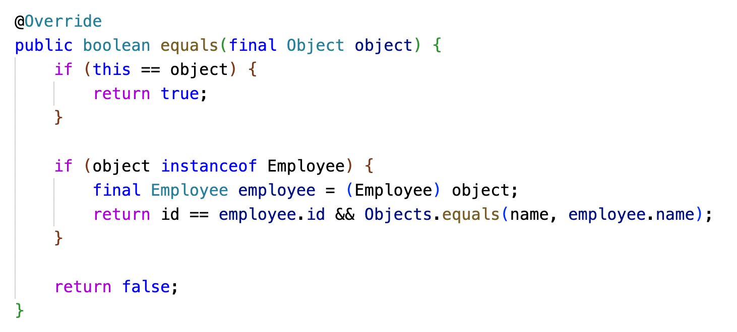
Traditional equals() method

Slide 5
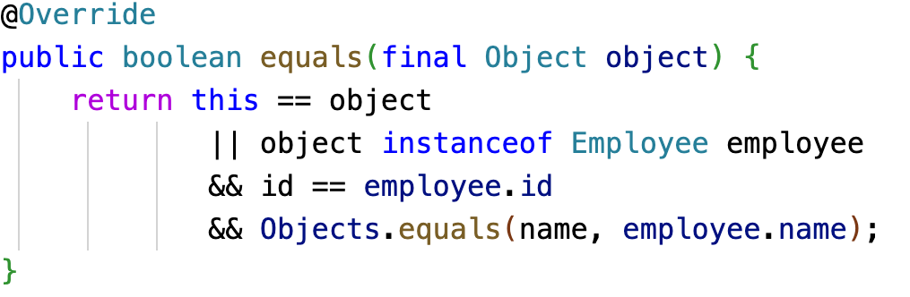
Simplified equals() method

Slide 6
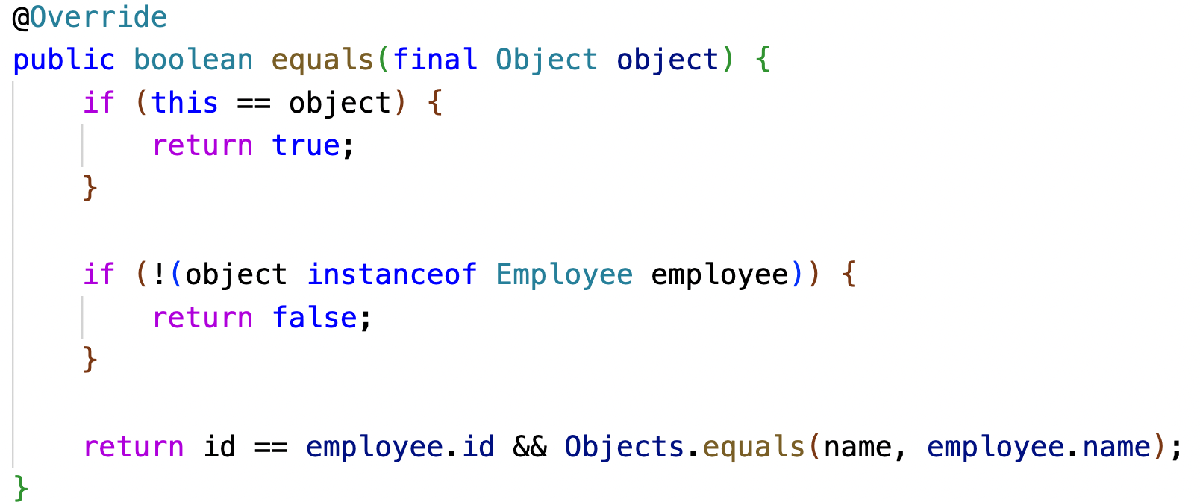
Flow Scoping

Slide 7
switch Pattern Matching
JEP 427: Pattern Matching for switch (Third Preview)

Slide 8
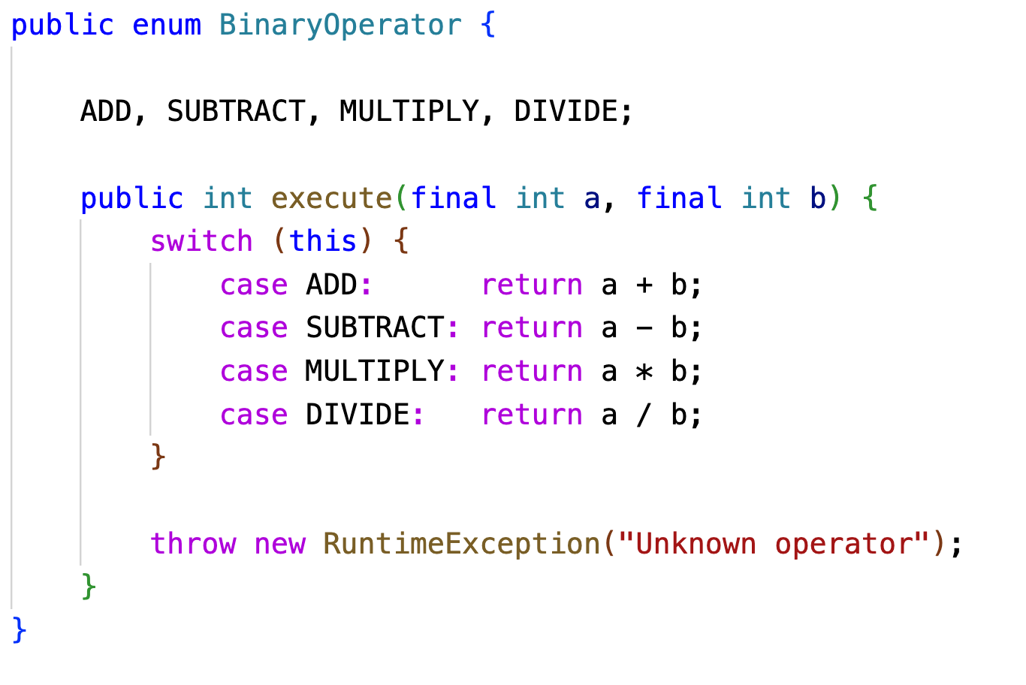
Enum Switch Case

Slide 9
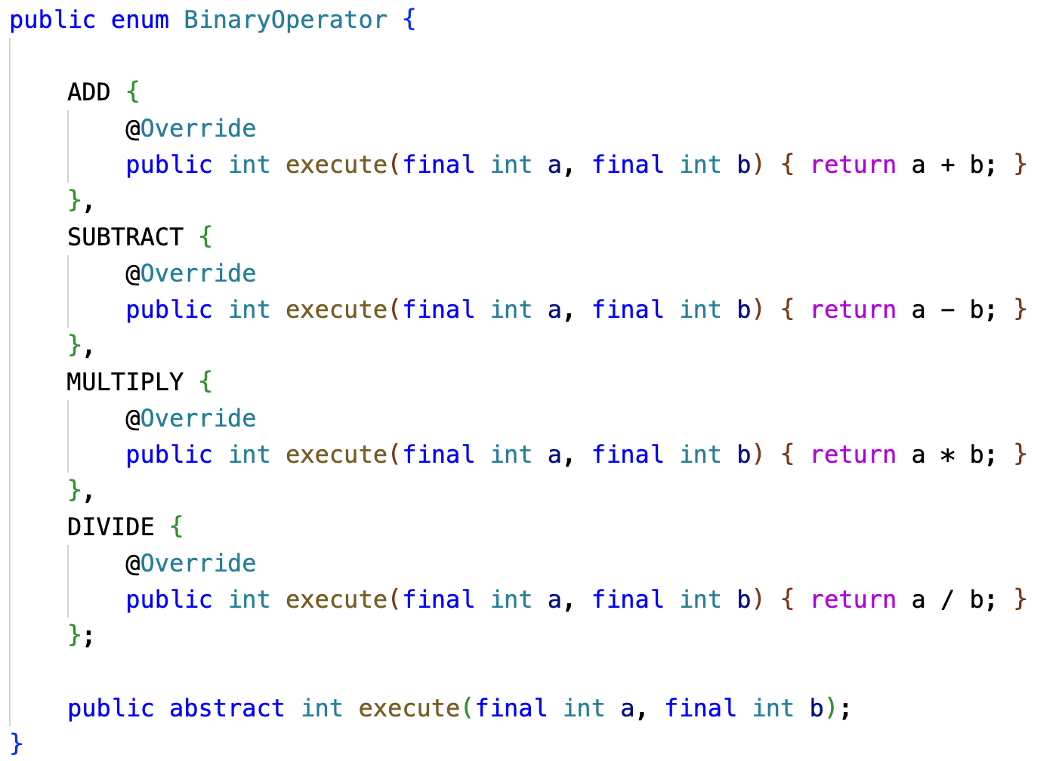

Slide 10
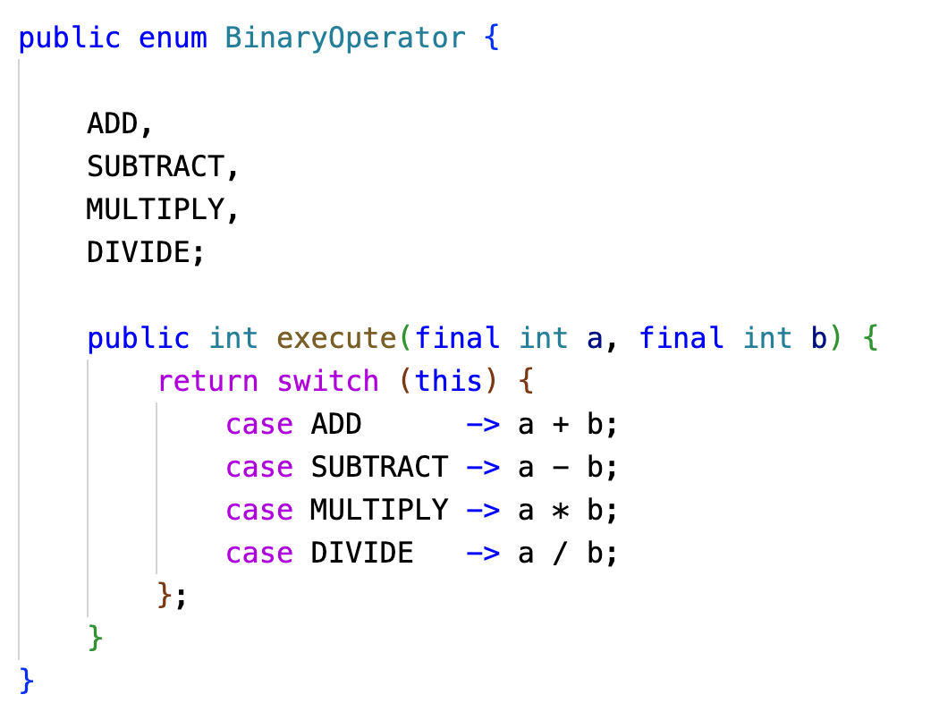

Slide 11
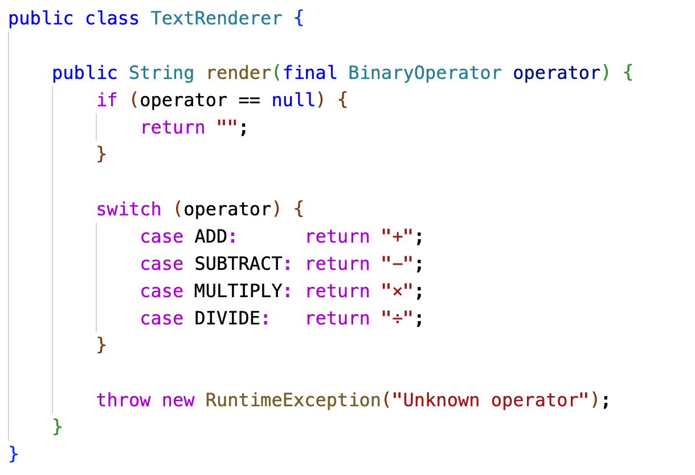

Slide 12
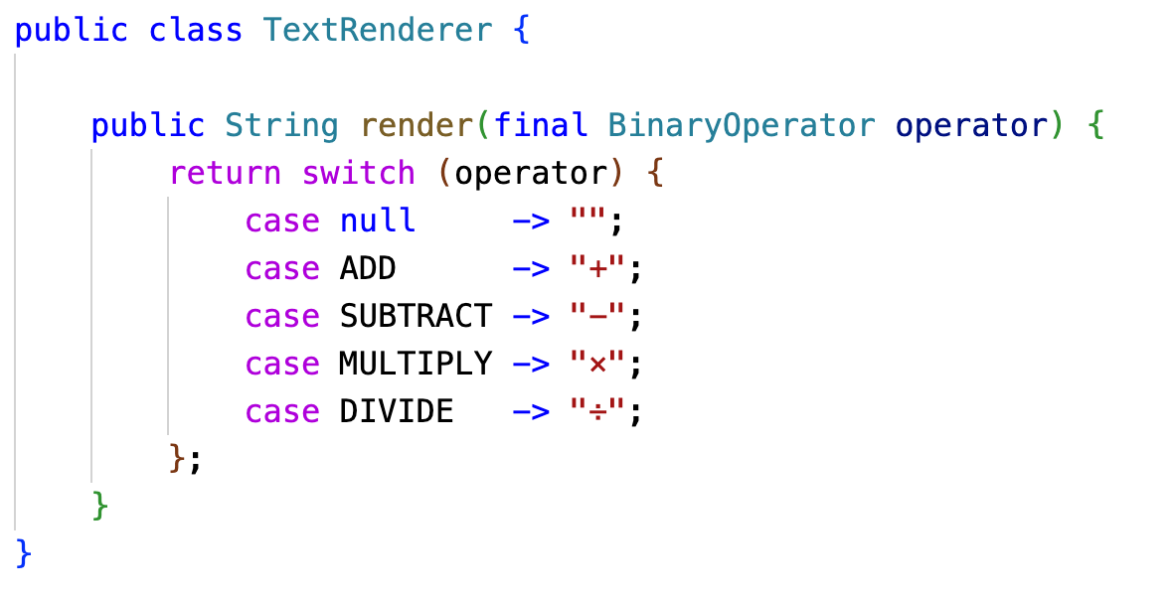

Slide 13
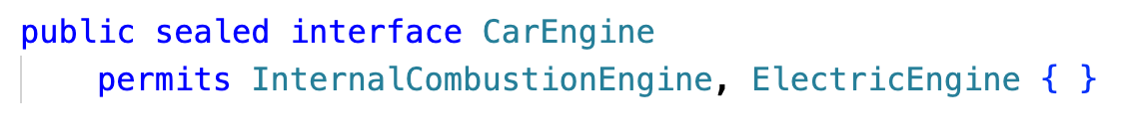
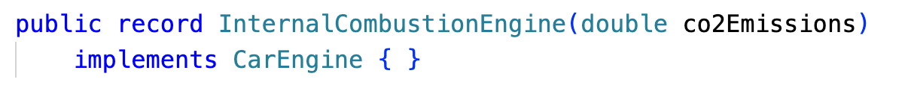

Slide 14
